Slide 1

What is an Separators?
Separators are symbols used to separate different parts of a C++ program, like statements, parameters, and blocks of code. They help structure and organize the code properly.
Types of Separators :
1.Semicolon (;)
Ends a statement
Example: int a = 10;
2.Comma (,)
Separates multiple variables or arguments
Example: int x = 5, y = 10;
3.Parentheses (( ))
Used in function calls, condition checks, loops
Example: if (x > 0), sum(a, b)
4.Braces ({ })
Define the beginning and end of a block of code
Example:{
}
5.Brackets ([ ])
Used for array declarations and indexing
Example: arr[0] = 5;
6.Colon (:)
Used in labels (for case in switch or inheritance)
Example: case 1:, class B : public A
7.Hash (#)
Used for preprocessor directives
Example: #include <iostream>
www.opentechz.com

Slide 2
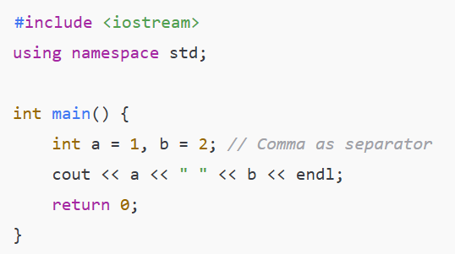

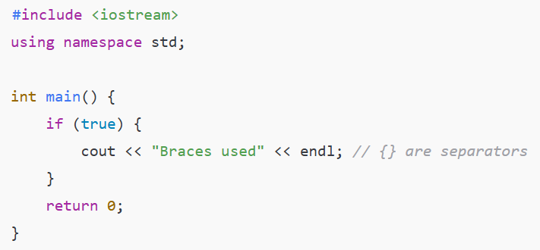

Example 1:
Example 2 :
www.opentechz.com

Slide 3
Data Types
A data type tells the compiler what kind of data a variable can hold — such as integers, characters, floating-point numbers, etc.
Why important? Because it defines:
The type of data stored
The memory size
The operations that can be performed
Classification of Data Types
Primary : int, float, double, char, bool, void
Derived : Arrays, Functions, Pointers, References.
User-defined : Structures (struct), Unions (union), Classes
www.opentechz.com

Slide 4
Primary(Built-in)
Data Type | Size (Bytes) | Range | Default Value | Example
int | 4 | –2,147,483,648 to 2,147,483,647 | 0 | int age = 25;
short | 2 | –32,768 to 32,767 | 0 | short temp = 100;
long | 4 or 8 | Larger than int | 0 | long distance = 100000;
unsigned int | 4 | 0 to 4,294,967,295 | 0 | unsigned int u = 50;
float | 4 | 1.2E–38 to 3.4E+38 (6–7 digits precision) | 0.0 | float pi = 3.14f;
double | 8 | 2.3E–308 to 1.7E+308 (15–16 digits precision) | 0.0 | double g = 9.81;
char | 1 | ASCII 0 to 127 | '\0' (null) | char grade = 'A';
bool | 1 | true or false | false | bool isPass = true;
void | 0 | No data | N/A | void display();
www.opentechz.com

Slide 5
Derived
Derived data types are based on primary (built-in) types and provide more complex ways to work with data, such as collections, addresses, or functions.
Data Type | Description | Syntax Example | Use Case
Array | Collection of fixed-size elements of same type | int marks[5]; | Store multiple values under one name
Pointer | Stores the memory address of another variable | int *ptr = &num; | Dynamic memory, passing by address
Function | Group of code that performs a task | int add(int a, int b); | Code reuse, modular programming
Reference | An alias for an existing variable | int &ref = original; | Modify original variable via alias
www.opentechz.com

Slide 6
User-Defined
User-defined data types allow programmers to create their own types by combining existing data types to represent real-world entities.
Type | Keyword | Description | Example Usage
Structure | struct | Combines variables of different types under one name | struct Student { ... };
Union | union | Similar to struct, but shares same memory | union Data { ... };
Enum | enum | Used to define named integer constants | enum Color { RED, GREEN };
Class | class | Defines objects and behaviors using OOP | class Car { ... };
Typedef | typedef | Creates alias/nickname for data types | typedef int Marks;
Using | using | Modern version of typedef (C++11+) | using Age = int;
www.opentechz.com

Slide 7
What is a Variable?
A variable is a named storage location in memory that holds a value which can change during program execution.
Why Do We Use Variables?
To store input from users
To perform calculations
To track changing values during a program
Rules for Naming Variables (Identifiers):
Must start with a letter (A–Z or a–z) or underscore (_)
Can include letters, digits, and underscores
Cannot use C++ keywords (like int, if, return)
Cannot contain spaces or special characters (@, #, $)
Are case-sensitive (Age ≠ age)
www.opentechz.com

Slide 8
Syntax :
data_type variable_name = value;
Example :
int age = 25;
float salary = 45000.50;
Type | Syntax | Example | Description
Declaration Only | data_type variable_name; | int age; | Declares a variable without assigning a value
Declaration with Initialization | data_type variable_name = value; | float pi = 3.14; | Declares and assigns a value at the same time
Multiple Declarations | data_type var1 = val1, var2 = val2; | int x = 5, y = 10; | Declare and initialize multiple variables in one line
Initialization Later | First declare, then assign value later | int num; num = 100; | Useful when value is unknown at the time of declaration
Constant Initialization | const data_type var = value; | const int max = 50; | Value cannot be changed once assigned
www.opentechz.com

Slide 9
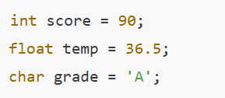
Types of Variable Storage
Single Variable : Holds one value
Multiple Variable : Holds Many values
Single Value Variables
Store only one piece of data per variable
Simple and useful for basic operations
www.opentechz.com

Slide 10
Multiple Value Variables
Technique | Description | Example
Array | Group of similar values | int marks[3] = {90, 85, 78};
Structure | Group of different types under one name | struct Student { int roll; float marks; }; Student s1 = {101, 88.5};
Class | Object with variables and functions | class Product { public: int id; string name; float price; };
Vector | Dynamic version of array (C++ STL) | #include <vector> vector<int> scores = {90, 85, 95};
Array of Struct | Multiple structured records | Student s[10];
www.opentechz.com

Slide 11

Thank You
www.opentechz.com

